Slide 1

Comprehensive OLA Ride Analysis Dashboard
Ramesh k
Data & Product Analyst

Slide 2
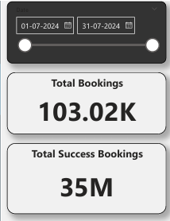
Objective:
Showcase key operational metrics for OLA rides.
Deliver actionable insights to improve efficiency, revenue, and customer satisfaction. Scope:
Ride trends, revenue, cancellations, and ratings analysis for July 2024.
Introduction

Slide 3
Pain Points
Identified Challenges:
High Cancellation Rate
(26.88%) leading to revenue loss.
Unbalanced Payment Preferences:
Over-reliance on specific methods like UPI.
Customer Retention: Lack of loyalty engagement for high-value customers.
Driver and Vehicle Management: Inefficiencies in ride assignment and cancellations due to personal/vehicle issues.

Slide 4
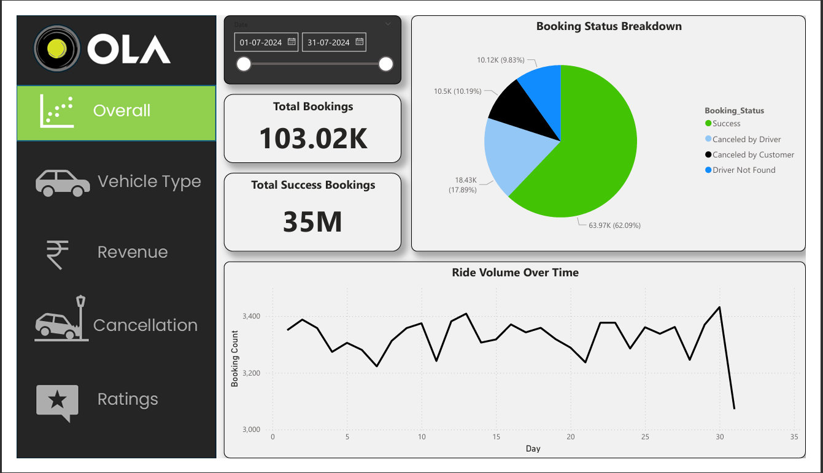
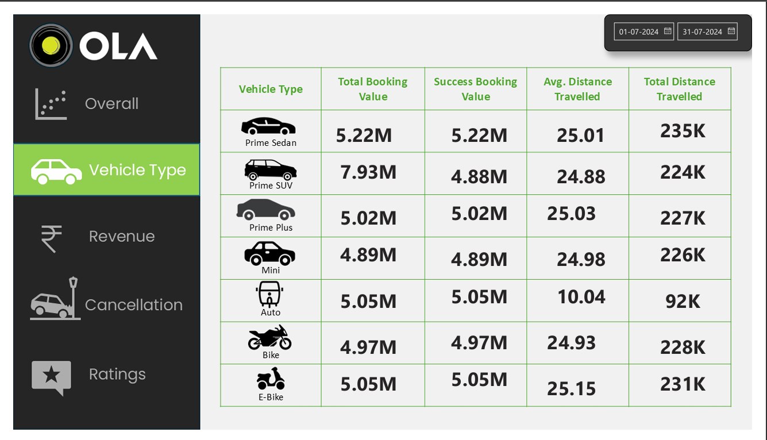
Dashboard Overview
Vehicle Type

Slide 5
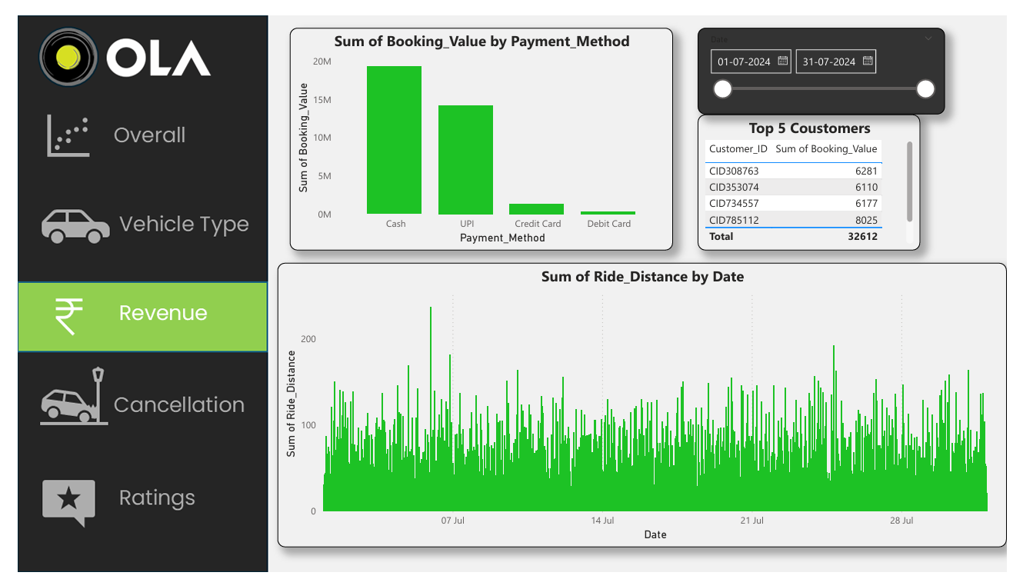
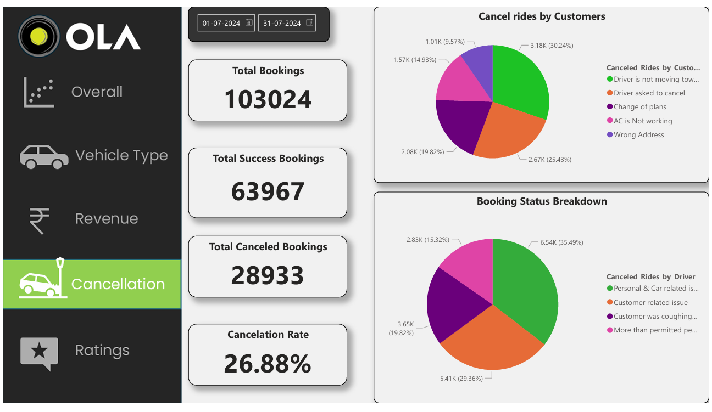
Revenue
Cancelation

Slide 6
Predictive Analytics
Future Forecasts:
Question 1
Revenue Growth: Estimated increase of 10-15% in Q3 2024 by addressing cancellation issues.
Question 2
Ride Volume: Monthly growth of 3.5% with improved booking success rates.

Slide 7
Business Recommendations
Step 1
Step 3
Introduce AI-based ride assignment for higher efficiency.
Incentivize drivers with rewards for fewer cancellations.
Promote Digital Payments
Campaigns with cashback and promo codes for UPI users.
Step 2
Step 4
Enhance Customer Loyalty
Offer discounts and personalized rewards for top customers.
Fleet Optimization
Prioritize vehicle allocation based on ride distance metrics.

Slide 8
Pain Points Addressed
Reduce Cancellation Rates (26.88%)
Implement AI-based ride allocation and driver incentives to save revenue and improve efficiency.
Streamline Operations
Optimize vehicle and driver management to reduce inefficiencies and enhance service reliability.
Boost Revenue by 10-15%
Promote diverse payment methods and target top customers with loyalty programs.
Enhance Customer Retention
Introduce personalized rewards and campaigns to retain high-value customers.

Slide 9

Thank you
Ramesh k
Ramesh k
Data & Product Analyst
My Portfolio
Contact

